Slide 1





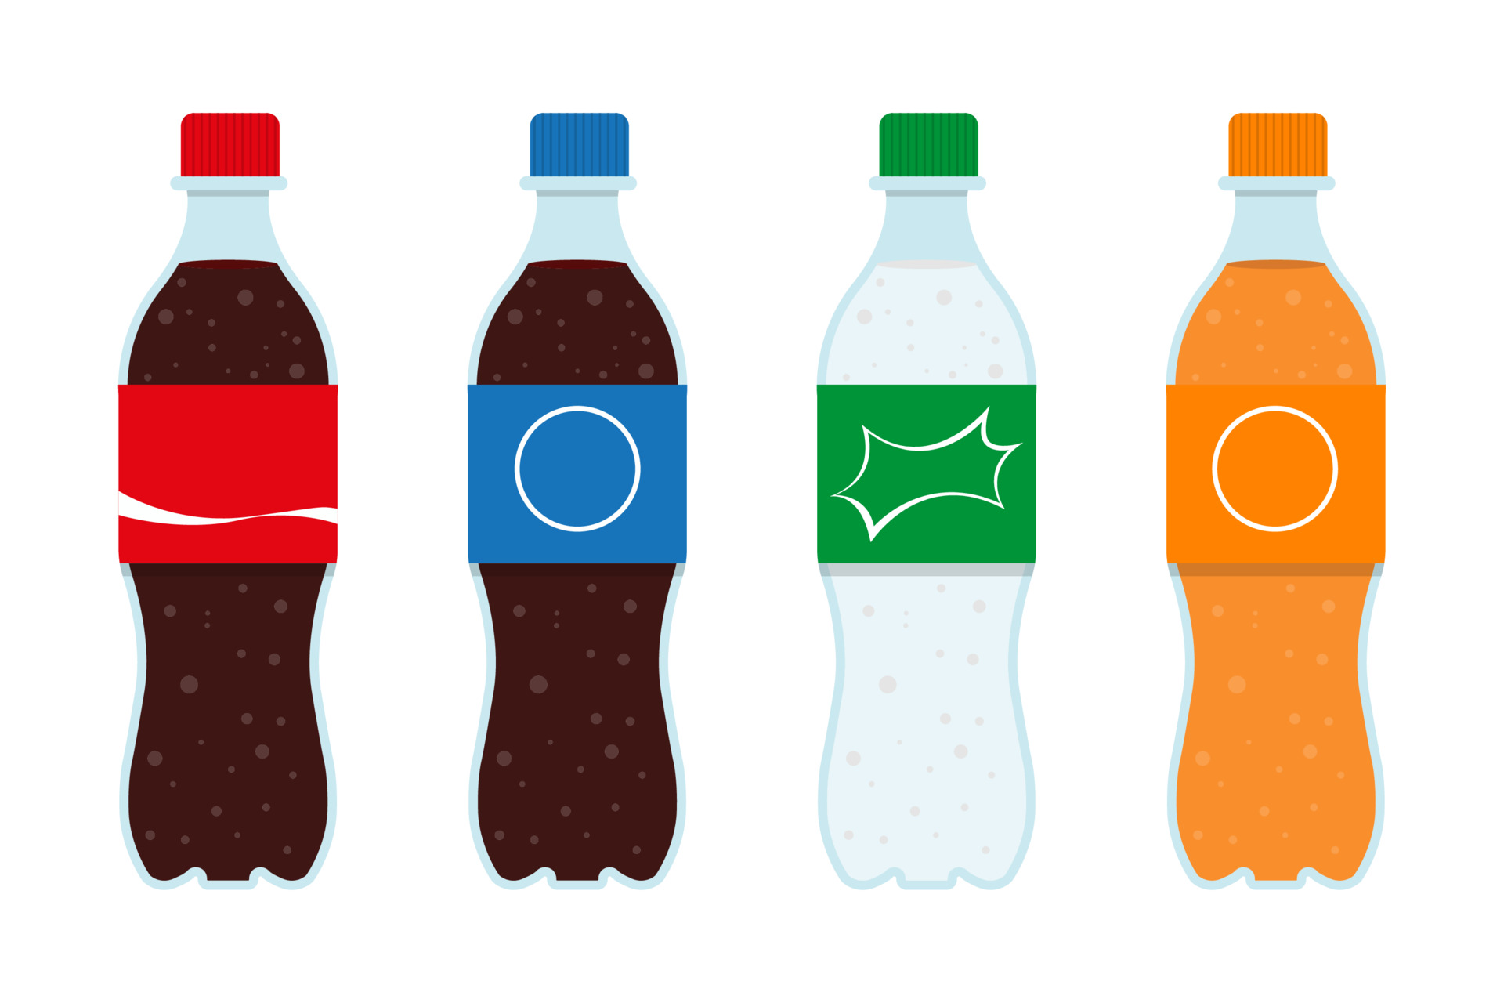




FAST FOOD FLASHCARDS – Set 1
www.englishwithjody.com
www.englishwithjody.com
www.englishwithjody.com
www.englishwithjody.com
www.englishwithjody.com
www.englishwithjody.com
www.englishwithjody.com
www.englishwithjody.com
www.englishwithjody.com
www.englishwithjody.com
www.englishwithjody.com

Slide 2
VEGETABLE FLASHCARDS – Set 1
www.englishwithjody.com
DOUGHNUT
CHOCOLATE
MILKSHAKE
BURGER
PIZZA
www.englishwithjody.com
www.englishwithjody.com
www.englishwithjody.com
www.englishwithjody.com
www.englishwithjody.com
CAKE
FIZZY
DRINK
HOT DOG
FRENCH FRIES
BISCUITS
www.englishwithjody.com
www.englishwithjody.com
www.englishwithjody.com
www.englishwithjody.com
www.englishwithjody.com

